Slide 1


PASSING THE BUCK
The Economics of Localizing Aid in Nigeria
CASE STUDY : NIGERIA
SEPTEMBER 2024

Slide 2
Sample
The analysis reviewed 46 projects funded through the CBPF, either directly or as subgrantees. Direct grants equate to $10.2m, or 41% of total funding to the CBPF in 2022/43% of funding in 2023.
This sample included:
6 UN projects, with 5 LNGO subgrants. Total value $3.3m, or 53% of total funding to UN in 2023.
6 INGO projects, with 8 LNGO subgrants. Total value $3.1m, or 33% of total funding to INGOs in 2023.
11 LNGO projects, with 10 LNGO subgrants. Total value $3.8m, or 29% of total funding to local actors in 2023.

Slide 3

Data Analysis
CASE STUDY : NIGERIA

Slide 4
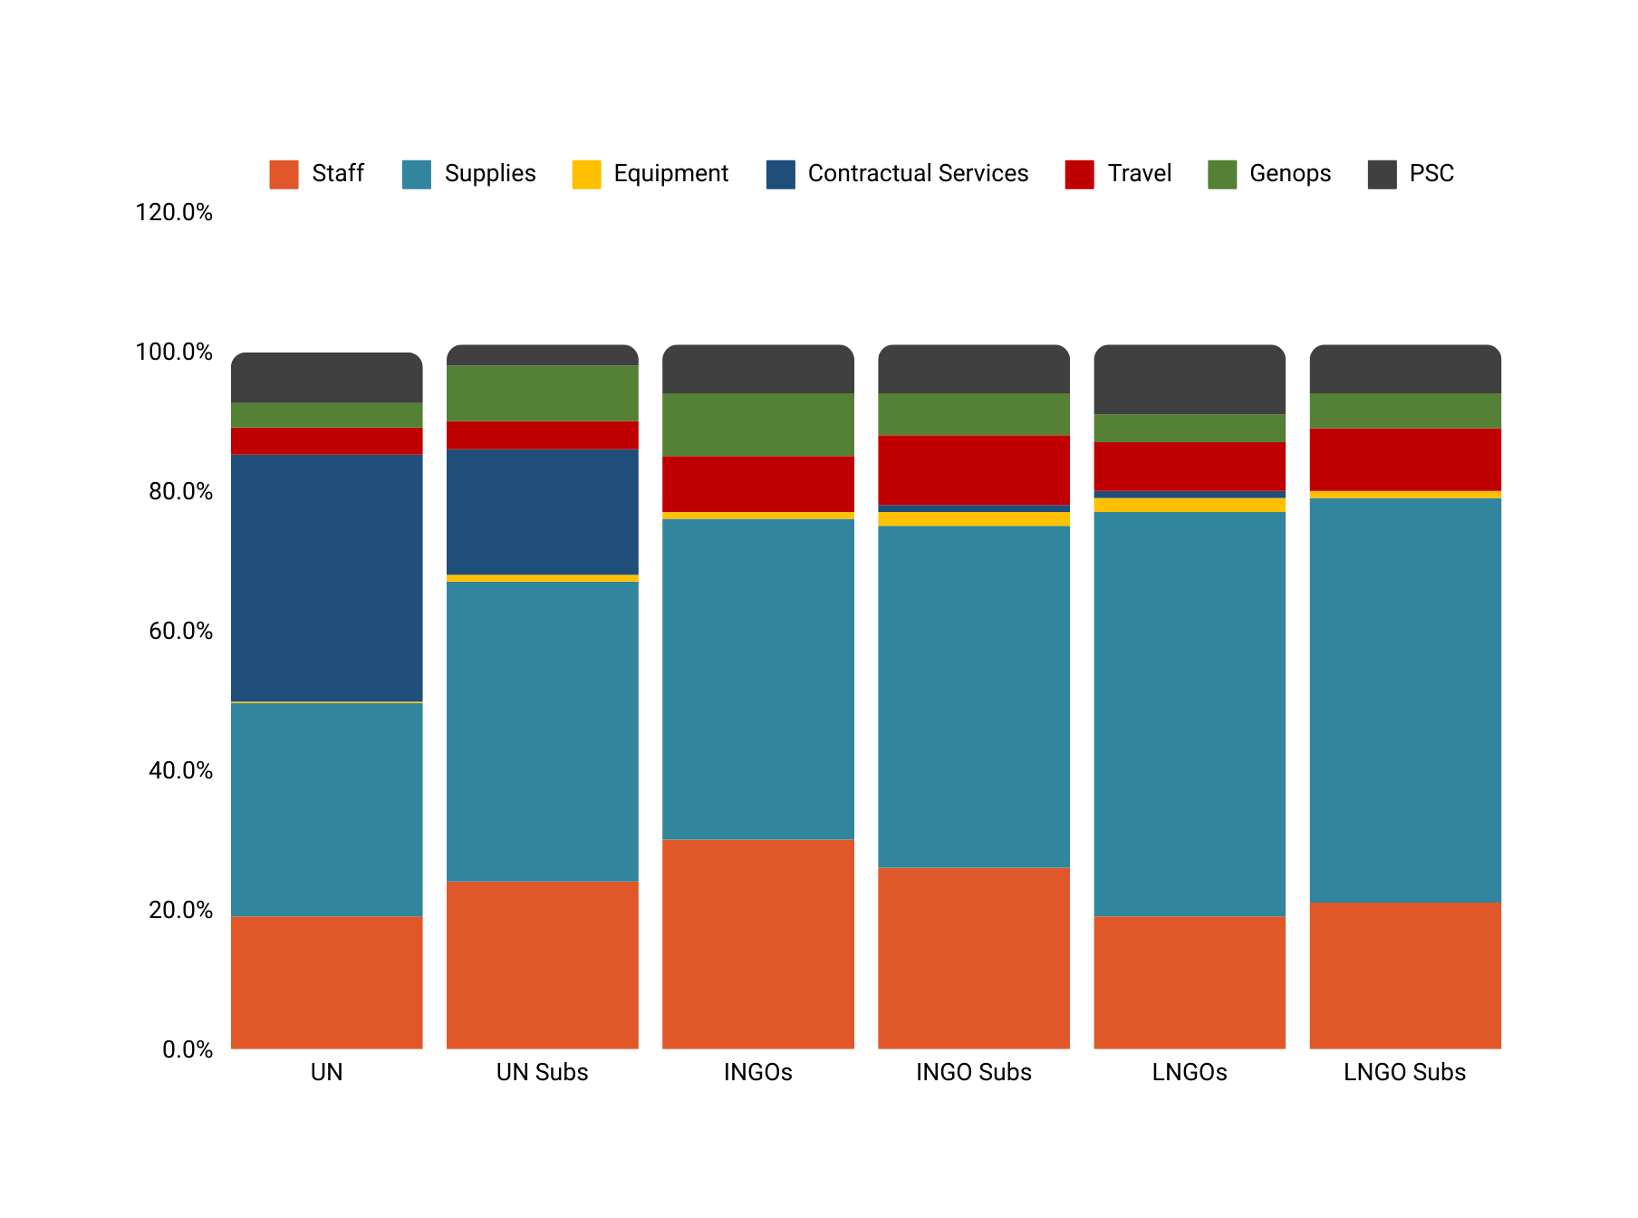
Average Budget by IP
Contract: 0%
PSC: 3%
PSC: 7%
PSC: 7%
PSC: 7%
PSC: 7.3%
Genops: 8%
PSC: 10%
Genops: 3.5%
Genops: 9%
Genops: 6%
Genops: 4%
Genops: 5%
Travel: 3.9%
Travel: 4%
Travel: 10%
Travel: 7%
Travel: 9%
Travel: 8%
Contract: 1%
Equip: 1%
Contract: 18%
Equip: 1%
Equip: 2%
Equip: 2%
Contract: 35.4%
Equip: 1%
Supplies: 46%
Supplies: 49%
Supplies: 58%
Supplies: 58%
Equip: 0.2%
Supplies: 43%
Supplies: 30.6%
Staff: 19%
Staff: 24%
Staff: 30%
Staff: 26%
Staff: 19%
Staff: 21%

Slide 5
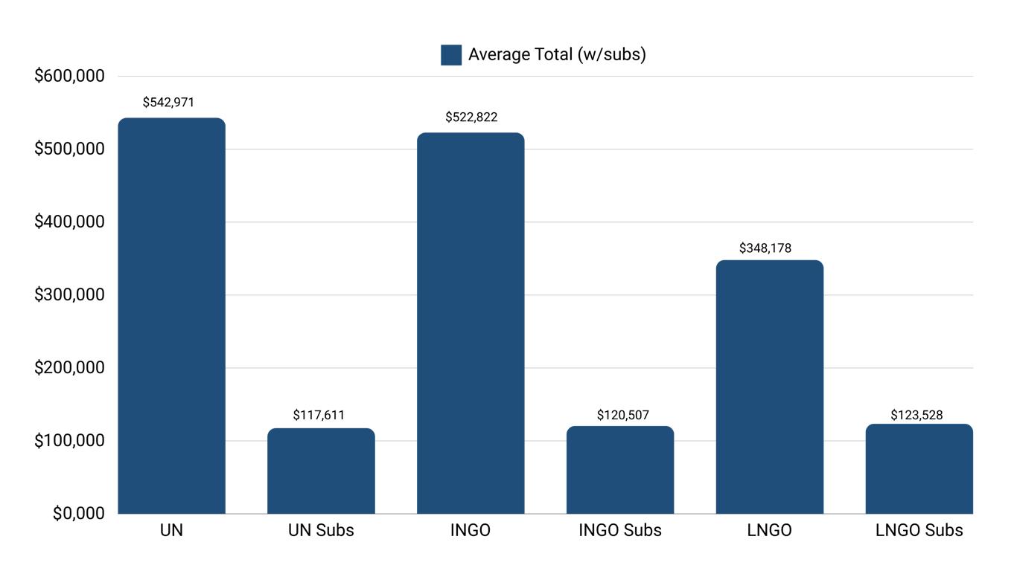
Average Grant Size by IP

Slide 6
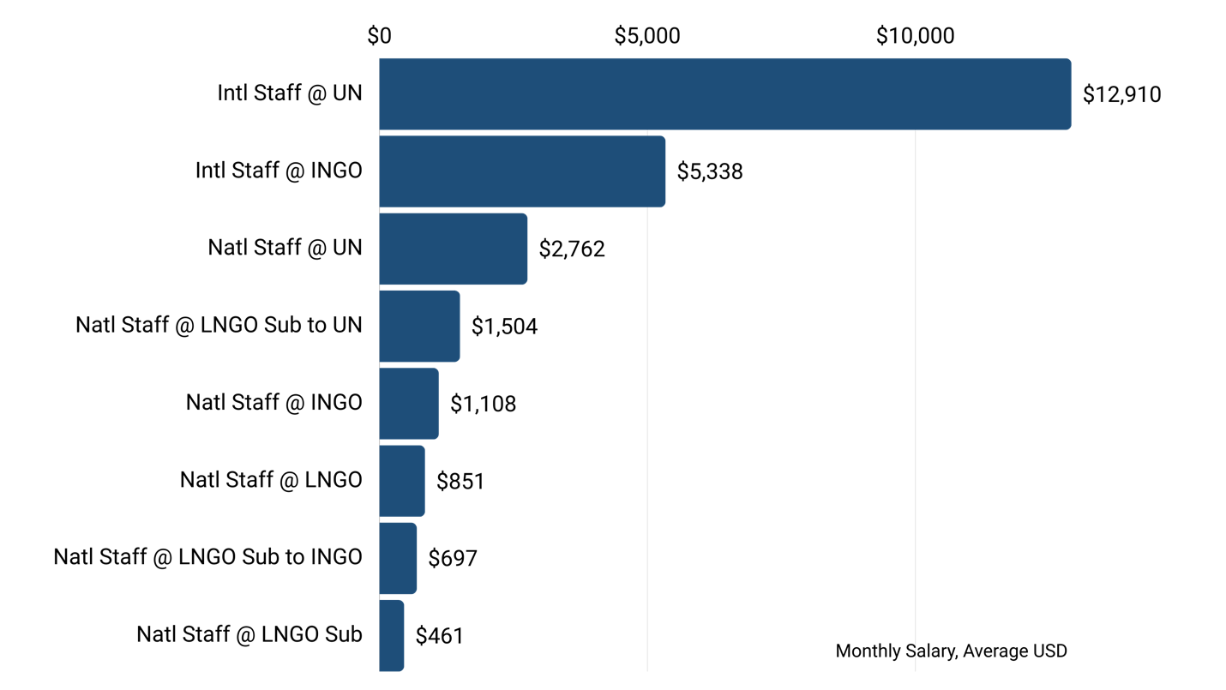
Monthly Staff Costs by IP

Slide 7
Key Takeaways
Sub-grants:
The UN and its subs have a much larger percentage of funds going towards procurement of supplies compared to the INGOs and LNGOs
Grant Size:
Average grant size for LNGOs is not far different from UN/INGOs – suggesting that LNGOs are capable of absorbing direct funding.

Slide 8
Key Takeaways
PSC:
The UN does not pass through PSC to its sub-grantees, until this year as now required by UNOCHA.
All INGO and LNGO agencies indicate full pass through of PSC.
Intl Staff:
International staff costs at the UN range between 5x national staff at the UN, and 28x national staff at LNGO subs.
International staff costs at INGOs range between 5x national at INGOs, and are 12x national staff at an LNGO sub.

Slide 9
Cost-Efficiency Analysis
CASE STUDY : NIGERIA

Slide 10
Methodology
Staff Costs:
        Total staff costs tagged according to Intl/Natl staff.
  Excluded staff costs for lower paid jobs to compare like with like (reviewed all job titles at Intl for keywords – e.g. Manager, Specialist, Lead – and tagged the same in Natl to exclude jobs like drivers and security guards).
  Calculated average monthly salary for different job types (presented above), used to calculate what the savings would be if jobs were moved from Intl to Natl.
  PSC:
  Adjust PSC according to World Bank PPP for Nigeria at 0.36.
  HQ Overheads:
  11.4% at UN; 13% at INGOs
  Split proportionally between Staff Costs and Overheads based on global data
  Adjusted using same methodology as above

Slide 11







Equitably Shifting Funding to Local Intermediaries
Staff & Overheads $875k
Convert to local rates
Total UN Funding
(6 Funded Projects)
$3.3 million
Savings of $690,753
(79% of Total Staff Costs & Overheads)
18.9%
cost efficiencies
Staff & Overheads $1.1 m
Convert to local rates
Total INGO Funding
(5 Funded Projects)
$3.1 million
Savings of $515,678
(48% of Total Staff Costs & Overheads)

Slide 12
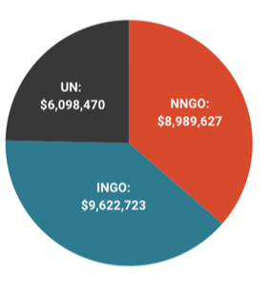
Total CBPF Funding 2023
Total Cost Efficiencies estimated at 18.9%
The CBPF already deployed 36% of its funds to local actors in 2022, and has realized estimated cost efficiencies of $1.6m on $9.0m of funding.
If 25% of remaining international funds in the CBPF in 2023 were shifted to local actors, additional cost efficiencies would be $467k.
UN: $6,098,470
INGO: $9,622,723
NNGO: $8,989,627

Slide 13

Total Humanitarian Response Funding 2023
The analysis finds that local intermediaries could deliver programming that is 18.9% more cost efficient than international intermediaries. Funding to Nigeria in 2023 totaled $645 million. If 25% of funds had been deployed to local actors, total cost efficiencies would be estimated at $30.4m in a single year.
Total Humanitarian Response Funding
$645 million
25% ($161 million)
total amount redeployed to local actors
$30.4m
cost efficiencies

Slide 14
Key Takeaways
Local partners can deliver funding 18.9% more cost efficiently than international actors.
These savings are most pronounced at UN: Local partners can deliver funding 79% more cost efficiently than the UN, and 48% more cost efficiently than INGOs.
A key finding from the analysis is the recommendation that all UN agencies are required to pass through PSC in full to sub-grantees.
The CBPF has already realized significant cost efficiencies by deploying funds to local actors, allowing it to reach more people in need.
The potential cost efficiencies over the full response – at an estimated $30m with a 25% shift in funding to local actors in a single year – are very significant.

Slide 15
Recommendations
Donors and international multilaterals such as the UN should establish full transparency on cost structures for delivering assistance.
Donors should stipulate/mandate that all UN agencies and INGOs operating in Nigeria are required to pass through full overheads to their Nigerian partners.
Donors should fund innovation and scale up pooled funds as a mechanism to shift more funding directly to local actors.
The analysis presented here should not be used to support arguments to de-fund the international aid architecture; rather, the whole response can be made significantly more efficient, effective and sustainable by engaging in a complementary response.
Identifying, strengthening and building local intermediary structures is key to realizing these gains, and investment in this area is critical.
Further work to assess the benefits of local response is needed.

