Slide 1




PASSING
THE BUCK
The Economics of Localizing Aid in Ukraine
CASE STUDY : UKRAINE
JULY 2024

Slide 2
Sample
The analysis reviewed 51 projects funded through the CBPF, either directly or as subgrantees. Direct grants equate to $55m, or 30% of total funding to the CBPF in 2023.
This sample included:
5 UN projects, with 9 LNGO subgrants; this includes 1 UN project with an INGO subgrant – this was flagged as an exceptional project and the INGO subgrant data was not included in the analysis, but used for a comparison point. Total value $21.1m, or 51.0% of total CBPF funding to UN.
5 INGO projects, with 15 LNGO subgrants. Total value $11.8m, or 11.4% of total CBPF funding to INGOs.
8 LNGO projects, with 9 LNGO subgrants. Total value $22.1m, or 61.6% of total CBPF funding to local actors.

Slide 3

CASE STUDY : UKRAINE
Data Analysis

Slide 4
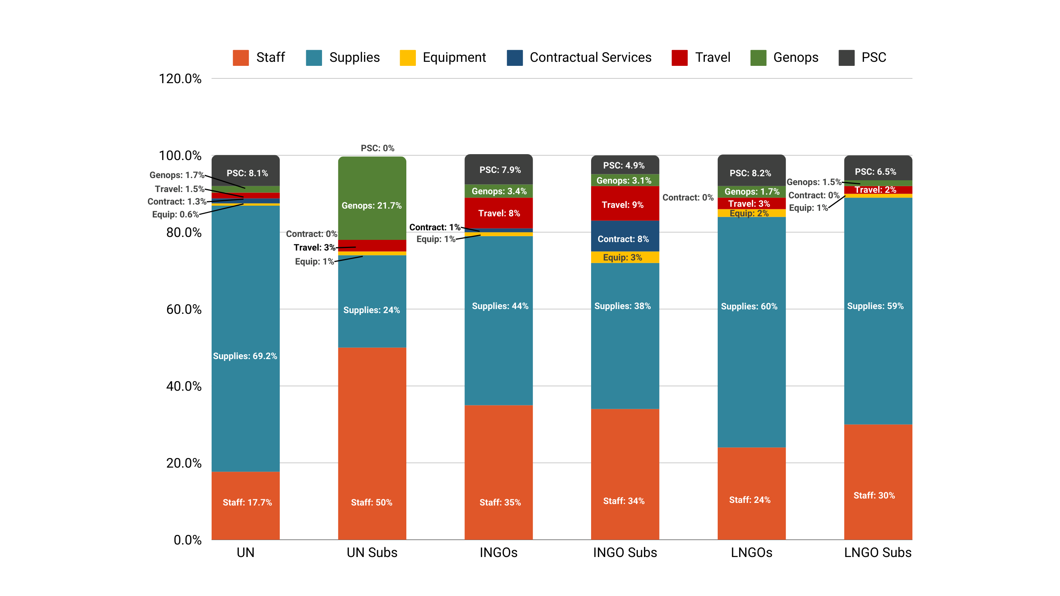
Average Budget by IP

Slide 5
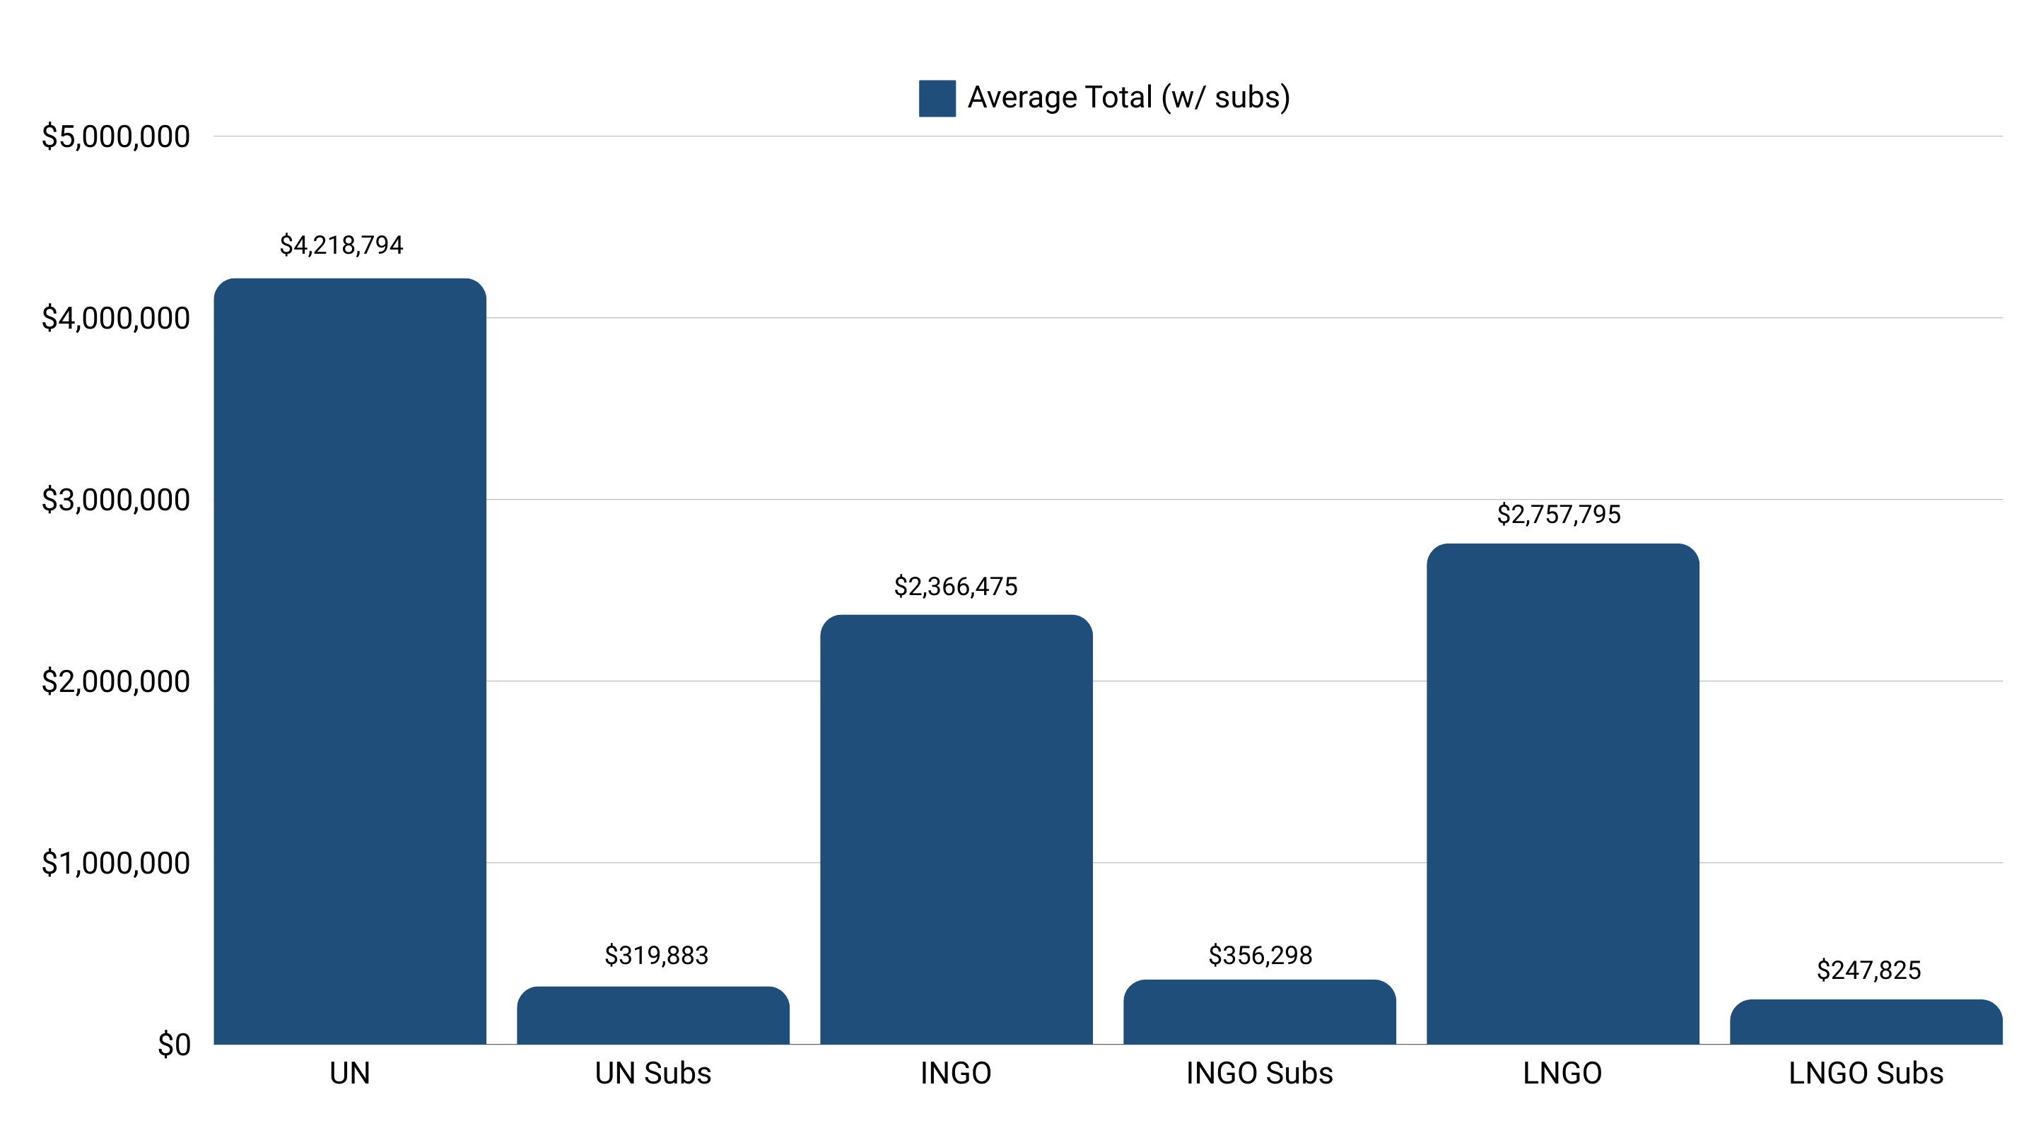
Average Grant Size by IP

Slide 6
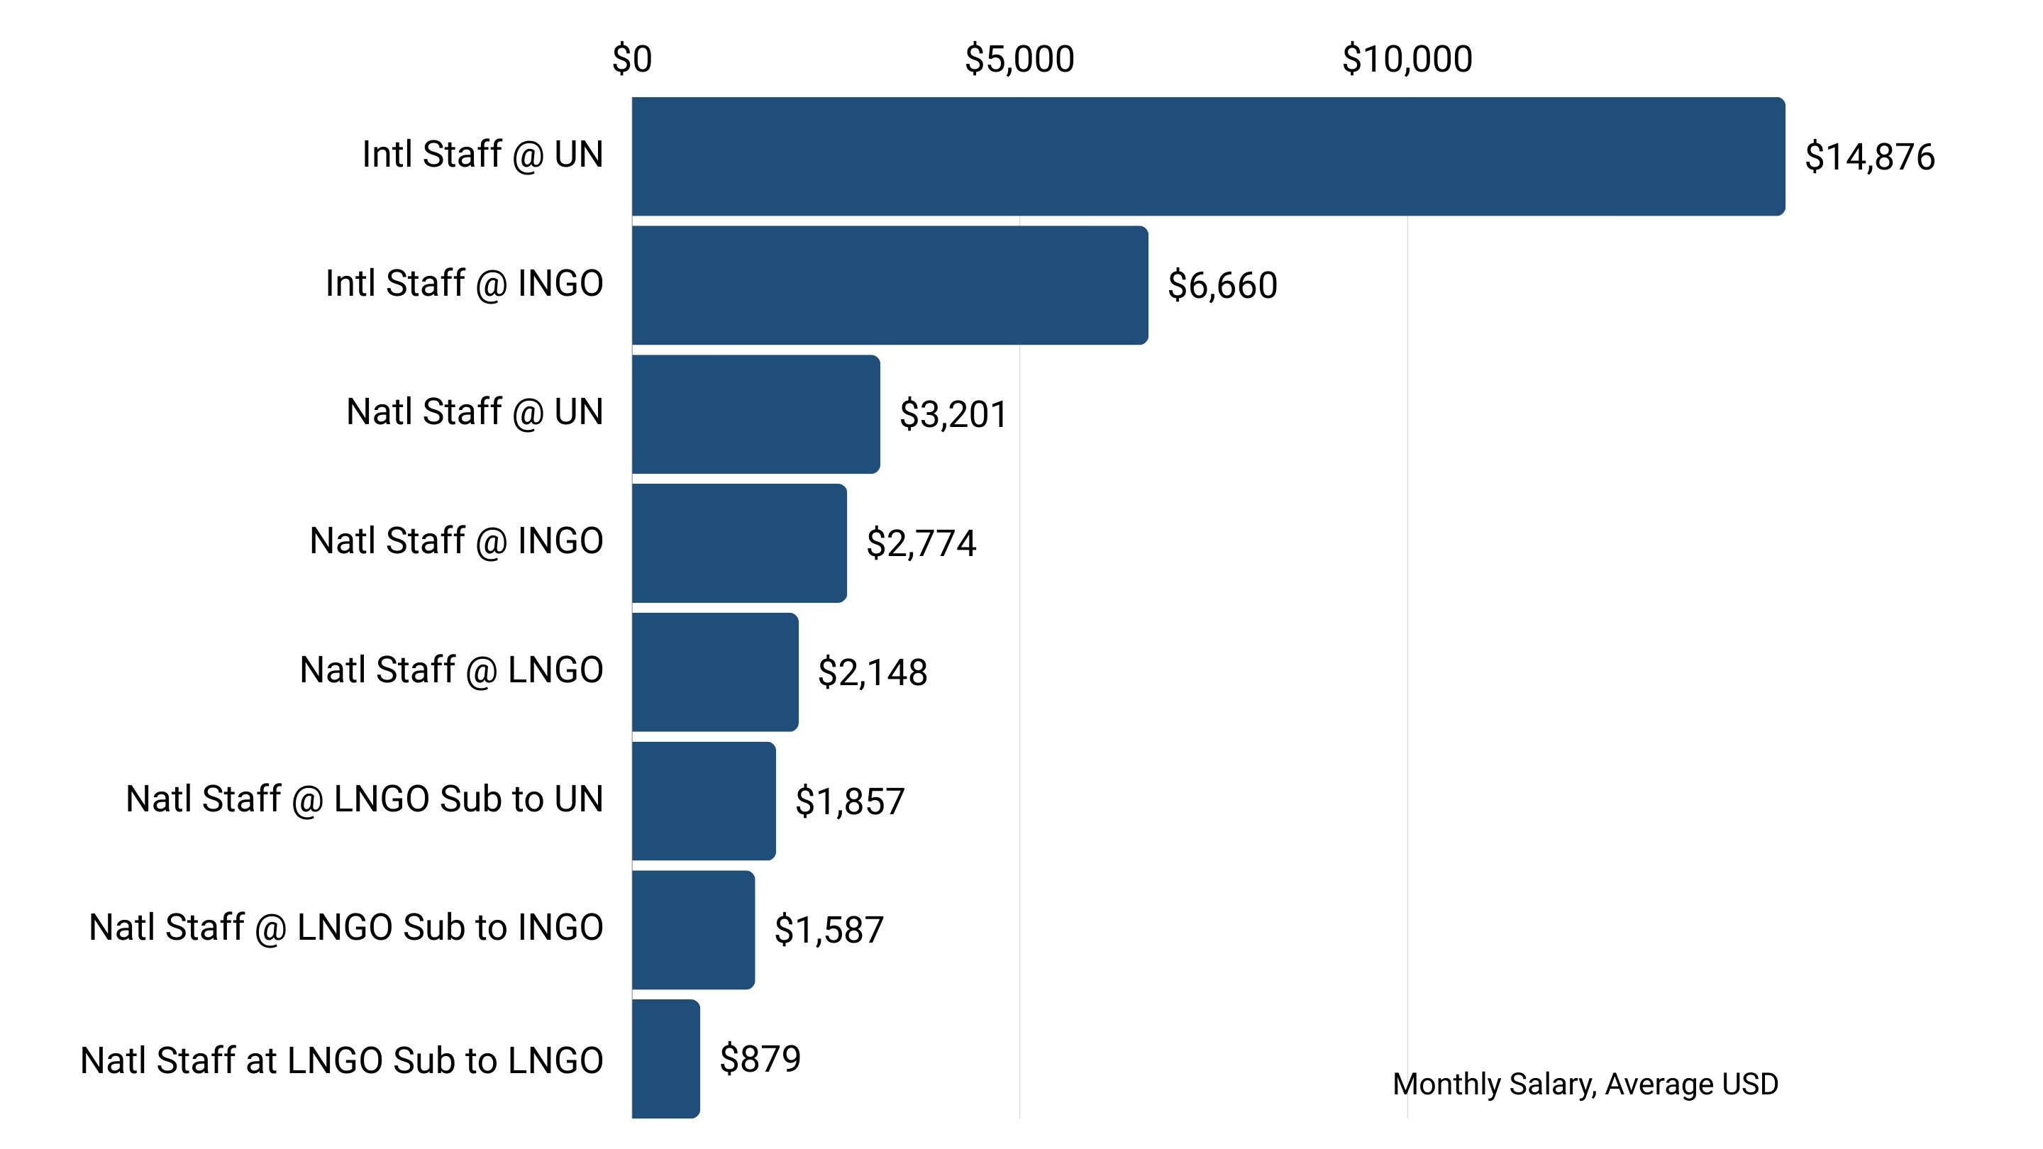
Monthly Staff Costs by IP

Slide 7
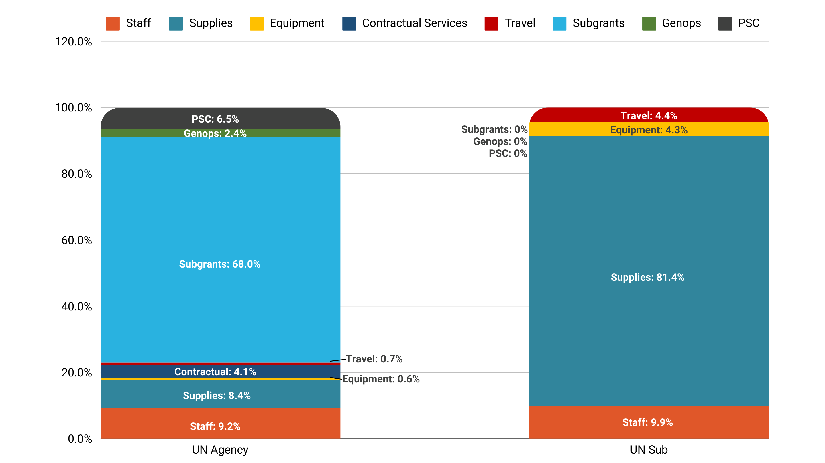
UN Prime and UN Subgrant Comparison

Slide 8
Key Takeaways
Sub-grants:
The cost structure between INGOs and LNGOs, and their respective LNGO subs, is not that different. However, the cost structure between UN and its subs is quite different – the UN spends the majority of its budget on procuring supplies (shelter kits, dignity kits, WASH, etc) and sub-grants to LNGOs for staff.
Grant Size:
Average grant size for LNGOs is actually more than INGOs – suggesting that LNGOs are capable of absorbing direct funding.

Slide 9
Key Takeaways
PSC:
The UN does not pass through PSC to its sub-grantees. The only exception was where a UN agency was subgranting to an INGO partner, and did pass through PSC. Otherwise, all sub-grantees were local partners with no passthrough.
All INGO agencies, with the exception of one, indicate full pass through of PSC.
Intl Staff:
International staff costs at the UN range between 5x national staff at the UN, and 17x national staff at LNGO subs.
International staff costs at INGOs range between 2x national at INGOs, and are 8x national staff at an LNGO sub.

Slide 10
Cost-Efficiency Analysis
CASE STUDY : UKRAINE

Slide 11
Methodology
Staff Costs:
        Total staff costs tagged according to Intl/Natl staff.
        Excluded staff costs for lower paid jobs to compare like with like (reviewed all job titles at Intl for keywords – e.g. Manager, Specialist, Lead – and tagged the same in Natl to exclude jobs like drivers and security guards).
        Calculated average monthly salary for different job types (presented above), used to calculate what the savings would be if jobs were moved from Intl to Natl.
  PSC:
  Adjust PSC according to World Bank Purchase Power Parity (PPP) for Ukraine at 0.28.
  HQ Overheads:
  11.4% at UN; 13% at INGOs
  Split proportionally between Staff Costs and Overheads based on global data
  Adjusted using same methodology as above

Slide 12
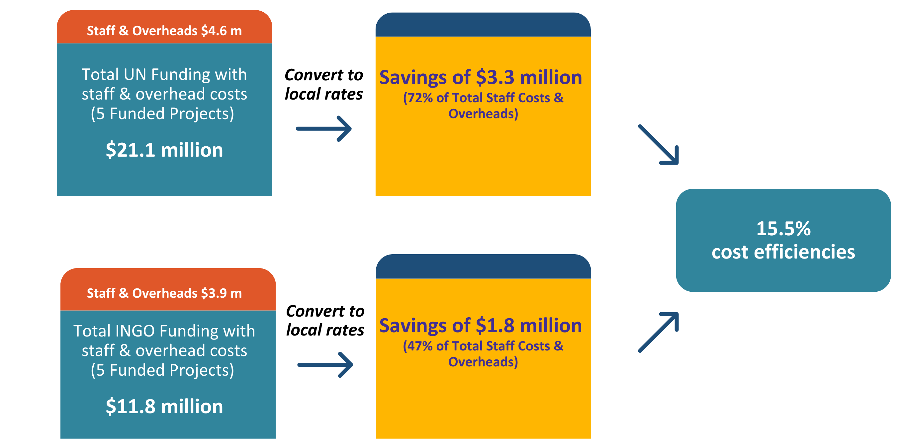
Equitably Shifting Funding to Local Intermediaries

Slide 13
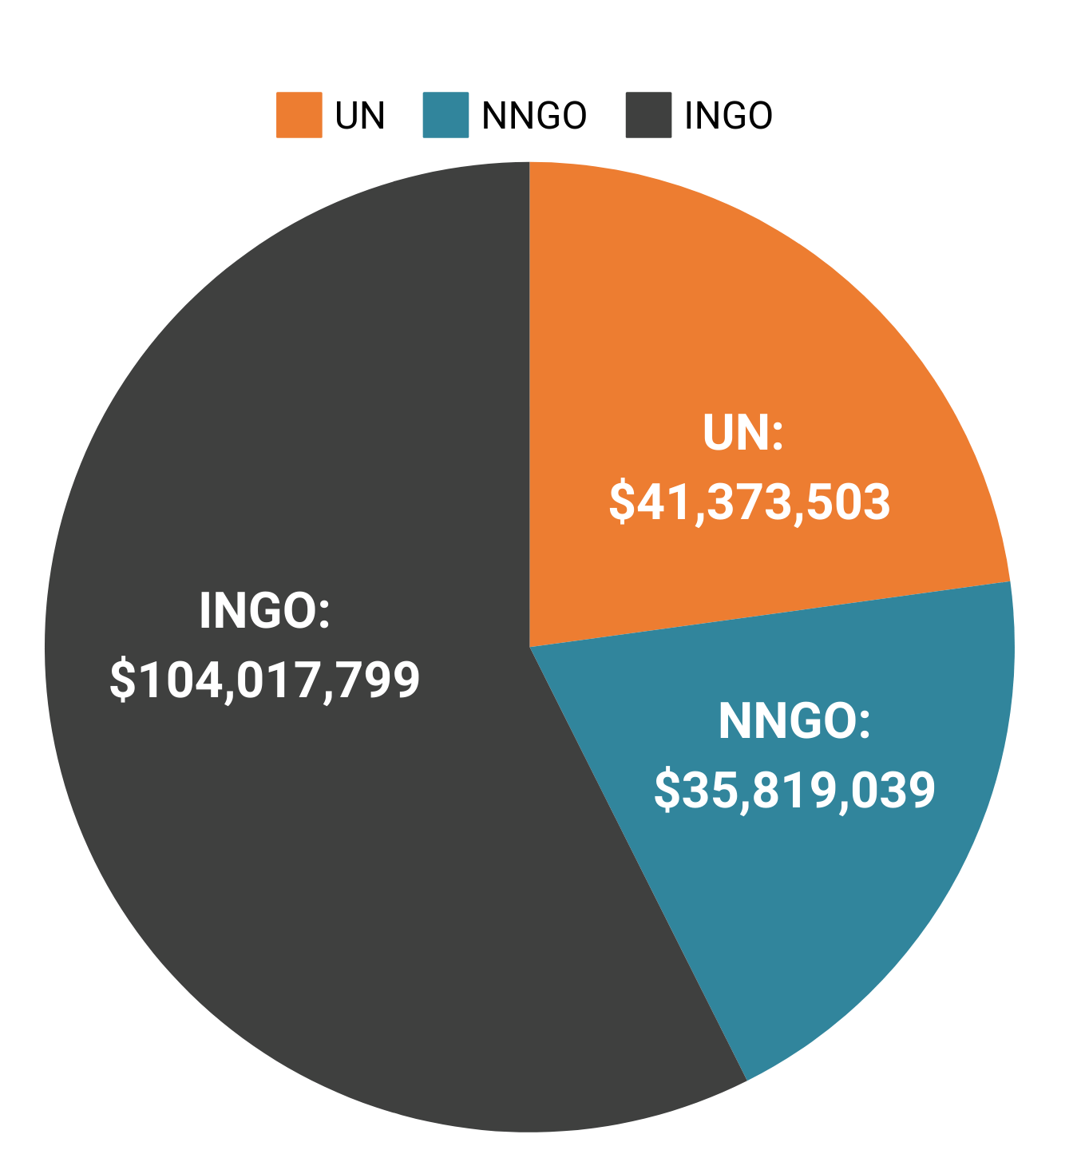
Total CBPF Funding 2023
Total Cost Efficiencies estimated at 15.5%
The CBPF already deploys 20% of its funds to local actors, and has realized estimated cost efficiencies of $5.5m on $35.8m of funding in 2023.
If 25% of remaining international funds were shifted to local actors, additional cost efficiencies would be $5.9m.

Slide 14

Total Humanitarian Response Funding 2023
The analysis finds that local intermediaries could deliver programming that is 15.5% more cost efficient than international intermediaries. Funding to Ukraine in 2023/estimated for 2024 totals $6.6 billion. If 25% of funds were deployed to local actors, total cost efficiencies would be estimated at $256m over 2 years.
Total Humanitarian Response Funding
$6.6bn
25% ($1.7bn)
total amount redeployed to local actors
$256m
cost efficiencies

Slide 15
Key Takeaways
Based on an evaluation of actual project data representing 30% of total funding via the CBPF, local partners can deliver funding 15.5% more cost efficiently than international actors.
These savings are most pronounced at UN: Local partners can deliver funding 72% more cost efficiently than the UN, and 47% more cost efficiently than INGOs.
A key finding from the analysis is the recommendation that all UN agencies are required to pass through PSC in full to sub-grantees.
The CBPF has already realized significant cost efficiencies by deploying funds to local actors, allowing it to reach more people in need.
The potential cost efficiencies over the full response – at an estimated $256m with a 25% shift in funding to local actors – are very significant.

Slide 16
Recommendations
Donors and international multilaterals such as the UN should establish full transparency on cost structures for delivering assistance.
Donors should stipulate/mandate that all UN agencies and INGOs operating in Ukraine are required to pass through full overheads to their Ukrainian partners.
Donors should fund innovation and scale up pooled funds as a mechanism to shift more funding directly to local actors.
The analysis presented here should not be used to support arguments to de-fund the international aid architecture; rather, the whole response can be made significantly more efficient, effective and sustainable by engaging in a complementary response.
Identifying, strengthening and building local intermediary structures is key to realizing these gains, and investment in this area is critical.
Further work to assess the benefits of local response is needed.

